Slide 1
Lost and Found Management System
The Lost and Found App is designed to help users report lost and found items efficiently. It provides a structured process for tracking, claiming, and resolving ownership disputes, ensuring a fair and transparent system for returning lost belongings.

Slide 2
Purpose of Alpha Testing
To identify functionality issues, bugs, and usability problems.
01
To verify that core features work as expected before moving to beta testing or public release.
02
To gather user feedback for further improvements.
03

Slide 3
Scope of Alpha Testing
Testing all core functionalities, including user registration, lost and found item management, claim processing, complaints, admin controls, and chat features.
01
Evaluating user experience and system performance.
02

Slide 4
Pre Testing Process
Selecting testers (3 users ComSci Students, 1 programmer, 1 MISTO head department, 3 employees, 1 common user )
Setting up test accounts with various roles (regular user, finder, admin, warning, suspended, deactivated).
Prepare test data (lost/found items, claims, reports).
Provide Checklist and Bug Report

Slide 5
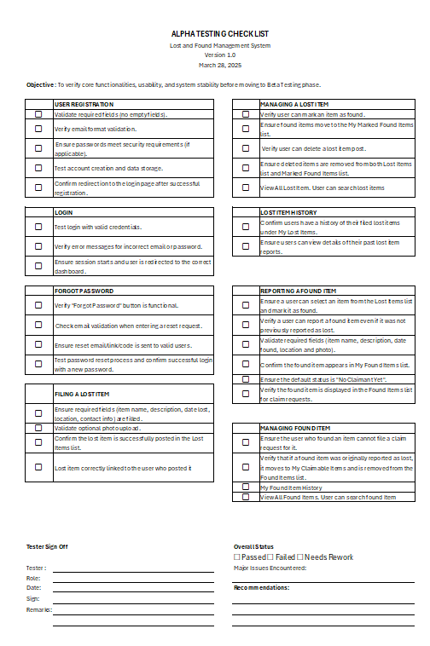
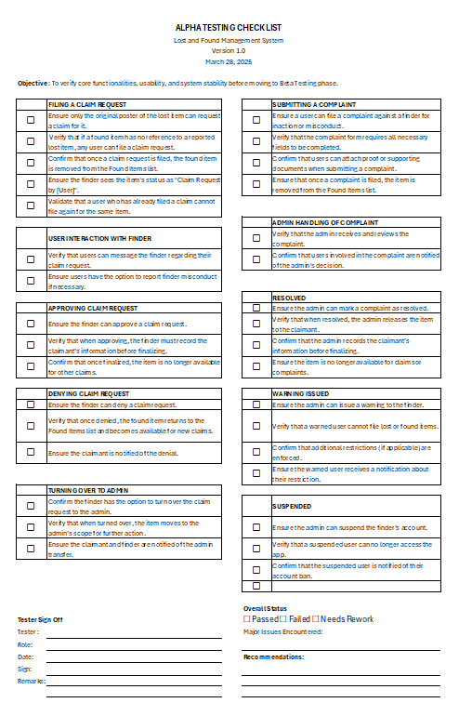
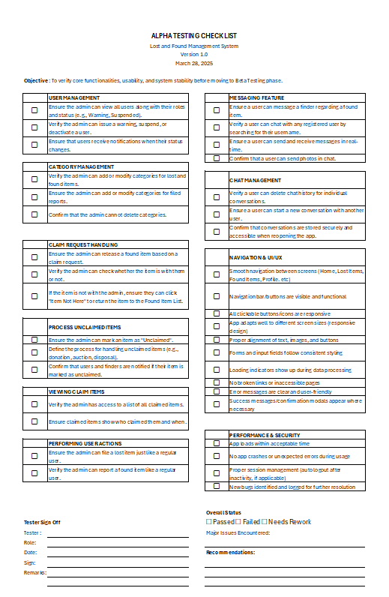
Checklist

Slide 6
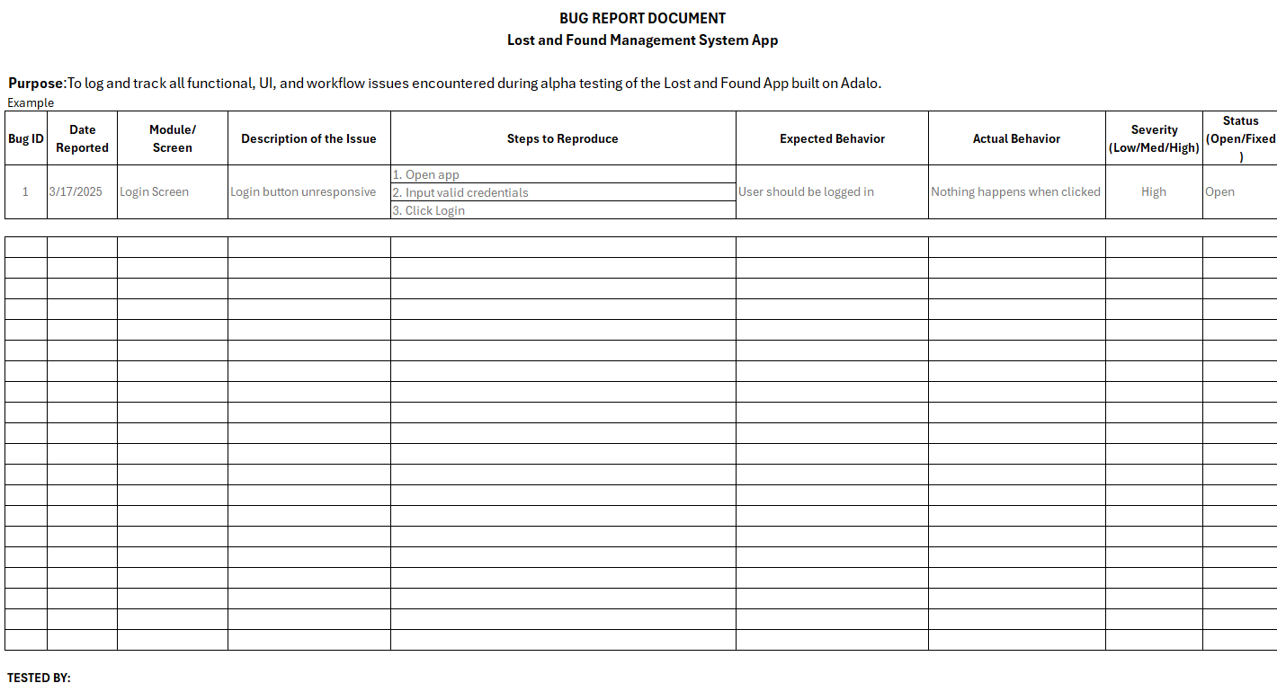
Bug Report Document

Slide 7
During Testing Process
Testers follow the Alpha Testing Checklist for each module.
Log issues in the Bug Report Document.
Evaluating system performance and usability.
Collect feedback on the user interface and experience..

Slide 8
Post Testing Process
Reviewing all reported bugs and feedback.
Categorizing issues into critical, major, and minor.
Prioritizing fixes and planning updates.

Slide 9
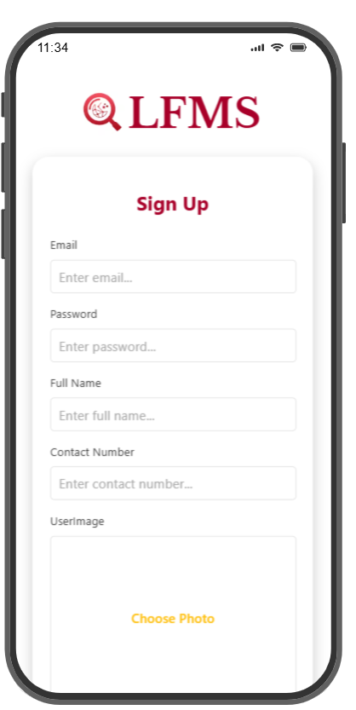
User Registration and Login
Test Case | Input Data | Expected Outcome | Actual Outcome | Severity
Enter Password Shorter than 8 characters | “Test1” | Should reject the password with an error message | System allows short passwords | ❌ High
User enters a password without a special character | “Test1234” | Should reject the password with an error message | System does not enforce special character requirement | ❌ High
User enters a contact number with letters or special characters | “09123abcd!@” | Should reject invalid input | System allows non-numeric characters | ❌ High
Test Case | Input Data | Expected Outcome | Actual Outcome | Status
Warned User when login | Warned User Login | Should still be able to login and directed to dashboard | Stuck in the Welcome screen | ❌ High
Recommendation:
Strengthen password validation to ensure compliance with security standards.
Correct the contact number validation logic to only accept valid numeric inputs.
Perform retesting after implementing fixes to confirm proper functionality.
Notes:
During our testing phase, we identified several critical validation issues, such as weak password acceptance and improper input handling. Due to time constraints and prioritization of core system functionalities, we were not able to fully implement all validation rules. However, we acknowledge the severity of these issues, and they are on our list for immediate improvement post-defense. We are committed to enhancing security and input validation to meet standard best practices.

Slide 10
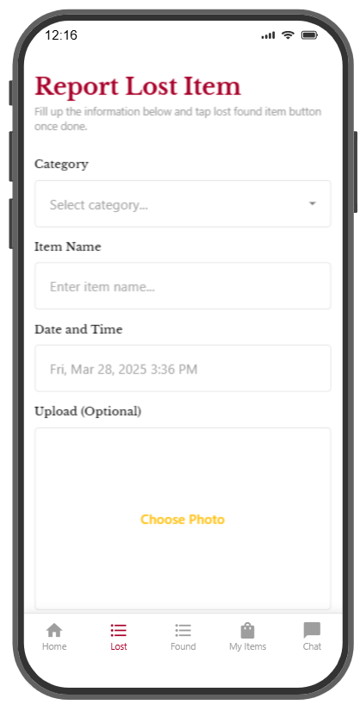
Lost Item Process
Test Case | Input Data | Expected Outcome | Actual Outcome | Severity
User enters a future date when reporting a lost item | 01/01/2030 | Should reject future dates | Accepts future dates | ❌ High
A user marks an item as found | User A clicks "Mark as Found" | Item moves to Found Item List | Item duplicates if another user also marks it as found | ❌ High
An item previously marked as found and reported back as lost | User attempts to mark as found again | Should be allow to mark the item as found from another user | No longer reported as found as the option shows only as delete or mark as found | ❌ High
Recommendation:
Implement validation to restrict future dates in the lost item reporting form.
Ensure that marking an item as found does not result in duplicate entries.
Perform retesting after implementing fixes to confirm proper functionality.

Slide 11
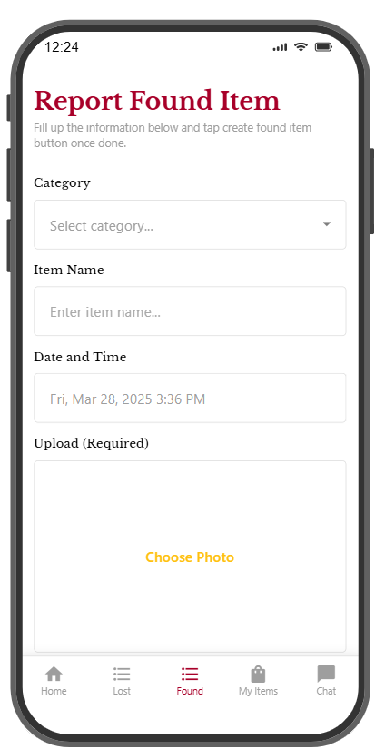
Found Item Process
Test Case | Input Data | Expected Outcome | Actual Outcome | Severity
User enters a future date when reporting a found item | “01/01/2030” | Should reject future dates | Accepts future dates | ❌ High
User deletes a lost item after it has been found | User clicks "Delete" | Should prevent deletion of already found items | User can still delete the item | ❌ High
Recommendation:
Implement validation to restrict future dates in the found item reporting form.
Ensure that marking an item as found does not result in duplicate entries.
Perform retesting after implementing fixes to confirm proper functionality

Slide 12
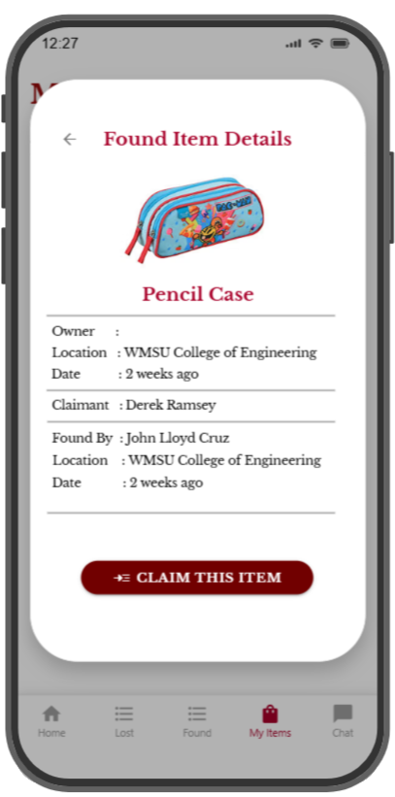
Claiming Process
Test Case | Input Data | Expected Outcome | Actual Outcome | Severity
Finder attempts to process a claim request for their found item | Finder selects “Claim this Item” | should prevent finders from processing their own claims | Finder can still process claim requests | ❌ High
User denies a claim request | User clicks "Deny" | should prompt for confirmation before denying | No confirmation message appears | ❌ High
User claims an item | Finder approves the claim | Item should be removed from the Found Items list | Item still appears in the Found Items list | ❌ High
Recommendation:
Restrict finders from processing claim requests for their own found items.
Disable marking or deleting lost items once they are found.
Add confirmation prompts when denying claim requests.
Ensure that claimed items are removed from the Found Items list.
Perform retesting after implementing fixes to confirm proper functionality

Slide 13
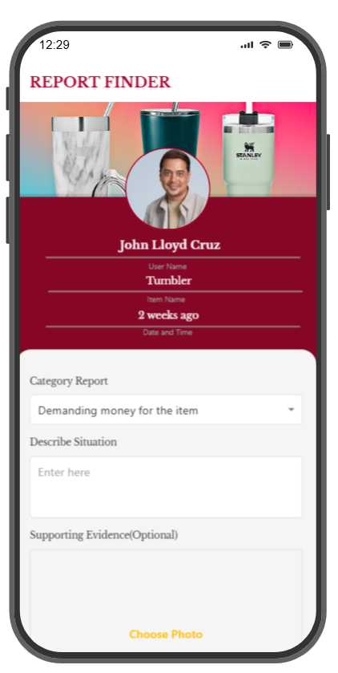
Complaint Filing
Test Case | Input Data | Expected Outcome | Actual Outcome | Severity
Filing Complaint | User selects an item and submits a complaint with details. | User can successfully file a complaint against a finder for inaction or misconduct. | Complaint submission was successful. | ✅ Passed
Form Validation | User attempts to submit a complaint with missing required fields. | System prompts the user to complete all necessary fields. | System correctly enforces required fields. | ✅ Passed
Attachment Functionality | User uploads proof (e.g., image, screenshot) and submits. | Attachments are successfully uploaded without errors. | Attachments were uploaded without issues. | ✅ Passed
Item Removal from Found List | User submits a complaint for an item in the Found Items list. | Once a complaint is filed, the item is removed from the Found Items list. | The item was successfully removed from the list after complaint submission. | ✅ Passed

Slide 14
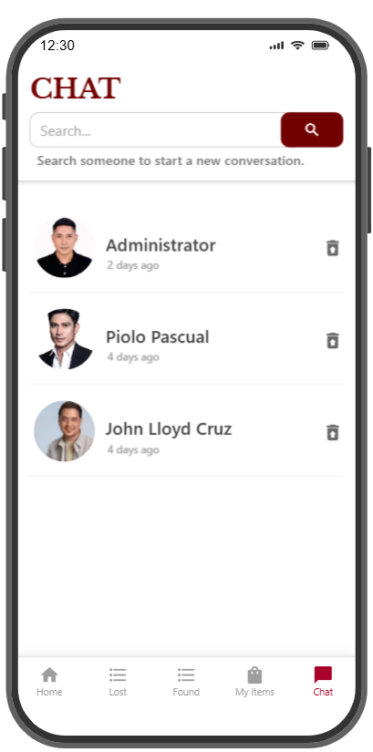
Chat Functionality
Test Case | Input Data | Expected Outcome | Actual Outcome | Severity
User messages a finder | User sends a message | Correct finder’s name should be displayed in chat | Incorrect name is displayed, but the message is received by the correct finder | ❌Medium
User starts a new conversation with another user | User creates a chat thread | Only one conversation entry should be in the inbox | Duplicate conversation entries appear for the same user | ❌Medium
Recommendation:
Fix chat name display so the correct finder’s name appears in messages.
Prevent duplicate conversation entries when messaging the same user.
Perform retesting after implementing fixes to confirm proper functionality

Slide 15
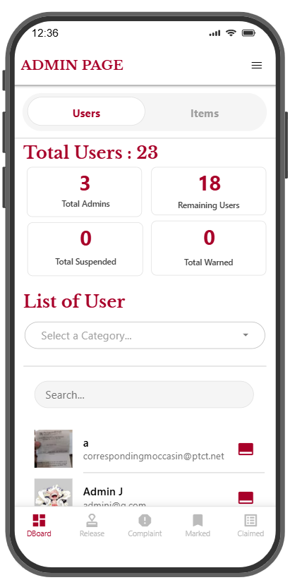
Admin Controls
Test Case | Input Data | Expected Outcome | Actual Outcome | Severity
Admin creates a new report category | Admin enters category name | Category should be created successfully | Creating new category is not set up yet | ❌ High
Admin marks an item as unclaimed | Admin selects "Mark as Unclaimed" | Item should be removed from current status and reset | Feature still in progress | ❌ High
Recommendation:
Implement full functionality for category management.
Complete the marking as unclaimed feature and test accordingly.
Perform retesting after implementing fixes to confirm proper functionality

Slide 16
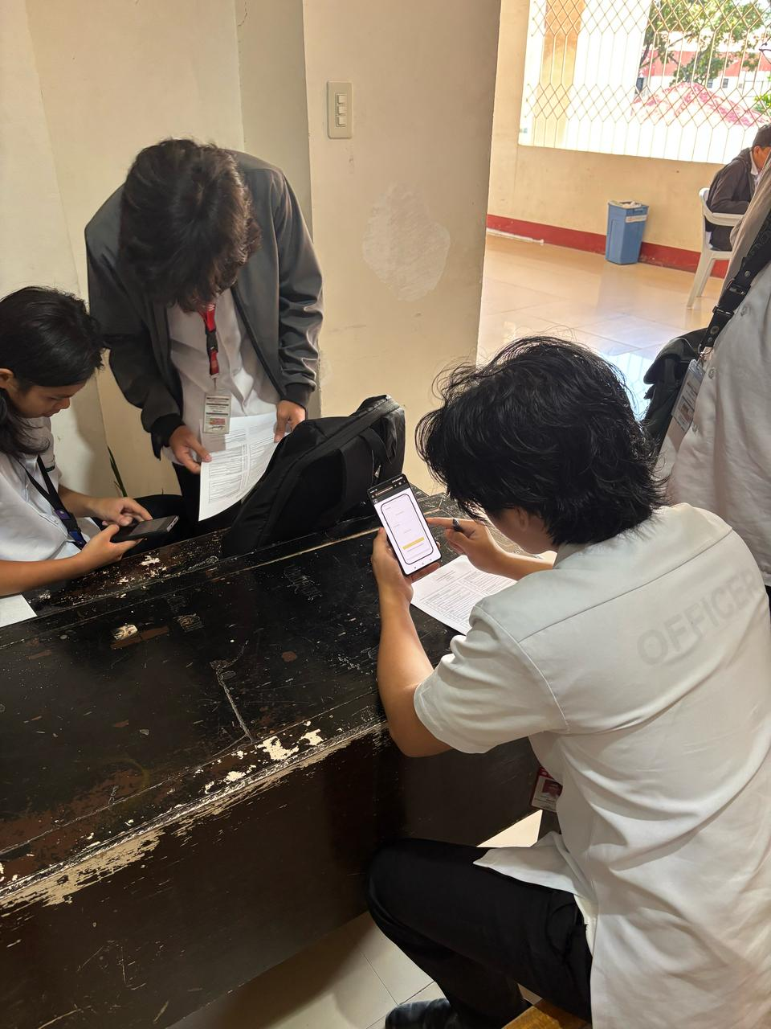
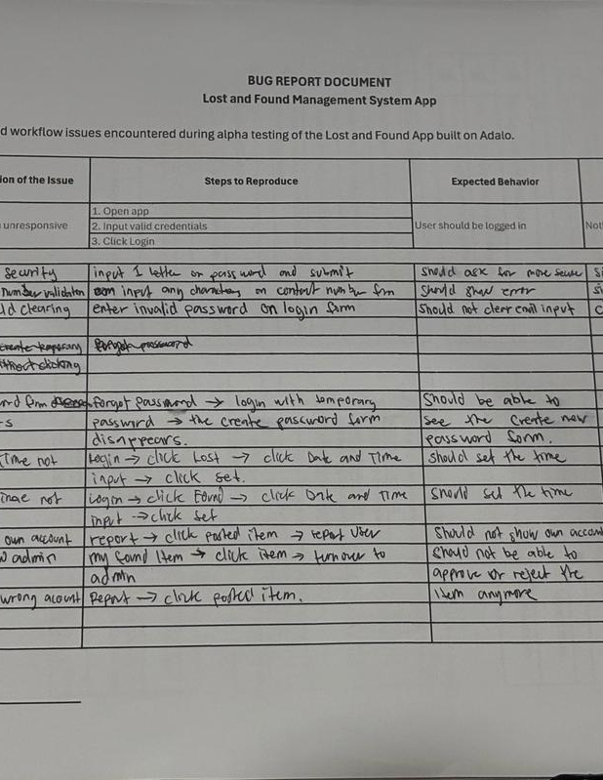
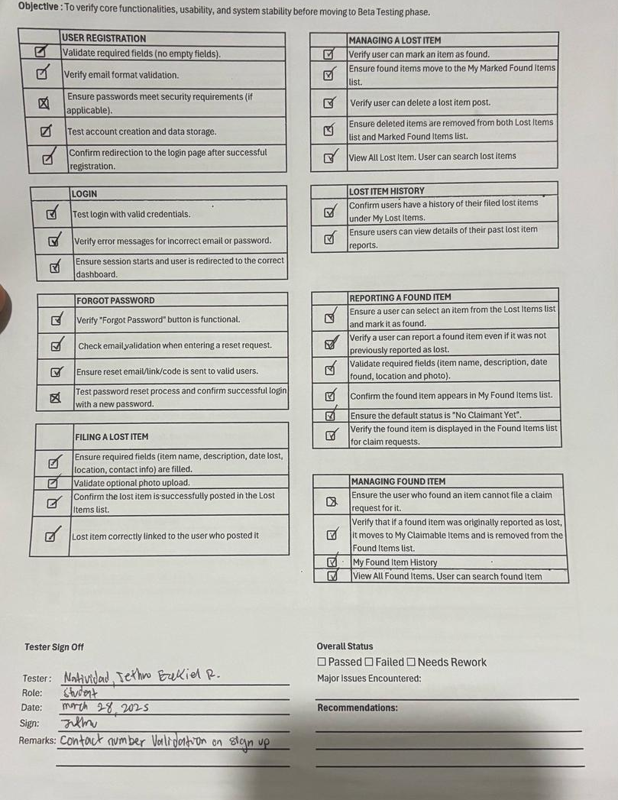
Documentation

Slide 17
Summary Performance and UX Feedback
User Experience Concerns
Lack of proper validation messages leads to user confusion.
Missing confirmation prompts can result in unintended actions.
Inconsistencies in chat functionality disrupt communication between users.
Performance Observations:
System experiences delays when handling item status updates.
Multiple users marking the same item as found leads to duplication and inconsistency.
Claim processing lacks clear flow and restrictions.

Slide 18

Conclusion
Immediate Bug Fixes – Address high-priority issues such as validation failures, duplicate entries, and incorrect process flows.
User Experience Enhancements – Improve system responsiveness, provide clear error messages, and streamline interactions.
Security and Integrity Improvements – Strengthen data validation and restrict unauthorized actions to prevent misuse.
Further Testing Cycles – Conduct additional rounds of testing after implementing fixes to ensure stability and reliability.
Notes:
The alpha testing phase has successfully identified critical issues that need to be addressed to enhance system functionality, security, and user experience. The current findings highlight gaps in validation, process integrity, and user interface consistency, which, if left unresolved, could lead to confusion, inefficiencies, and potential misuse of the system.
Ongoing feedback and iterative development are crucial for refining the system before moving into beta testing and final deployment. By actively engaging with users and testers, we can ensure that the system meets usability standards, performs efficiently, and aligns with the intended objectives. Regular testing cycles will also help prevent the recurrence of similar issues and allow for continuous improvements.
By fostering a culture of continuous improvement and incorporating iterative feedback, we can develop a more efficient, user-friendly, and secure lost-and-found system that meets both user expectations and operational requirements.

